Slide 1
Group - 20
PROJECT TITLE
Carryout System Requirement Study and architectural solution building for integrating and practicing Generative AI for following idealised businesses / Governance systems.
Problem Domain under consideration : Office of Chief Justice of India
Team Members:
2101091 - Maviya Qureshi.
2101109 - Anmol Preet Singh
2101114 - Kashik Sredharan
2101121 - Radha Tumbre
Guide:
Dr. G.T.Thampi

Slide 2
Areas of GenAI Integration in the Office of the Chief Justice of India
Judgment Drafting: AI can assist in drafting judgments, legal opinions, and administrative documents.
Benefits: Speeds up routine paperwork and ensures consistency.
Case Summarization: Concise summaries of lengthy legal documents and case files.
Benefits: Enhances efficiency in case management and review.
Legal Research: Automates research of previous cases, laws, and precedents offering relevant insights.
Benefits: Increases accuracy and saves time in case preparation.
Case Scheduling and Management: GenAI can automate case scheduling, prioritize urgent matters, manage judicial resources, and notify parties.
Benefits: Streamlines coordination, reduces delays, and optimizes judicial resources.

Slide 3
Areas of AI Integration in the Office of the Chief Justice of India
Public Assistance and Query Handling: Virtual assistants powered by AI can assist the public with common legal queries.
Benefits: Reduces administrative burden and improves public support.
Document Management: AI-based categorization, sorting, and archiving of legal documents and briefs. Streamlined document workflows and faster retrieval times.
Benefits: Improves document retrieval speed and workflow efficiency.

Slide 4
Requirements
AI-Powered Case Management System:
Case Classification: Automatically categorize cases based on legal domain and priority.
Judge Workload Balancing: AI to distribute cases evenly among available judges, taking specialization into account.
Case Prioritization: Prioritize cases based on urgency, public interest, and complexity.
Decision Approval: Allow the CJI to review AI-suggested case assignments before finalizing them.
AI-Driven Legal Research Assistant:
Contextual Search: AI to process complex legal queries and retrieve the most relevant legal precedents.
Document Summarization: Summarize long case documents and briefs into concise points for quick review.
Judgment Assistance: Suggest potential judgment outcomes based on precedent analysis.

Slide 5
Requirements
Automated Court Scheduling System:
Calendar Optimization: AI to propose optimal scheduling based on judge availability and case priority.
Real-Time Updates: Provide automatic updates to judges, lawyers, and litigants about hearing dates and changes.
Conflict Resolution: Automatically resolve scheduling conflicts or case adjournments.
Judicial Performance Monitoring:
Performance Metrics: Analyze the number of cases heard, delays, and judgment quality of each judge.
Misconduct Alerts: Flag irregular judicial behavior, such as bias in rulings or undue delays in delivering judgments.
Disciplinary Recommendations: Provide data-driven recommendations for judge transfers or disciplinary actions.

Slide 6
Requirements
Scalability:
The system must handle a large volume of data from cases, judgments, and court schedules from the Supreme Court and High Courts.
The AI models should scale to handle increasing caseload and judicial data across India.
Security:
Implement strict data security protocols for sensitive case information, personal data of judges, and judicial decisions.
Use encrypted communication channels for transmitting case data and judgments.

Slide 7
Requirements
Accuracy:
Ensure high accuracy in AI-powered legal research and judgment assistance.
The AI system must be continuously updated with the latest legal databases, laws, and precedents
Transparency and Bias Mitigation:
Ensure that AI models used in judicial performance monitoring and case allocation are transparent, explainable, and free from bias.
Maintain detailed logs of AI decisions and the reasoning behind them for accountability.

Slide 8
Requirements
User Experience:
The system should be user-friendly, allowing judges, clerks, and other judiciary staff to interact seamlessly.
Provide intuitive interfaces for reviewing AI suggestions and making manual overrides when necessary.

Slide 9
Requirements
Hardware Required:
High-performance computing clusters: Clusters like NVIDIA DGX Stations or IBM Power Systems are used for training complex AI models quickly and efficiently.
GPUs for AI computations: NVIDIA A100 Tensor Core GPUs or Google’s TPUs (Tensor Processing Units) can significantly reduce the time required for AI model processing, making it practical for real-time case classification and legal research.
Secure servers: HPE ProLiant DL380 or Dell EMC PowerEdge R940 servers can provide the security and storage capacity needed for handling sensitive judicial data.
Advanced workstations: Workstations like the Lenovo ThinkStation P620 or HP Z8 G4 offer the necessary processing power for judges and legal personnel to interact with AI applications seamlessly.

Slide 10
Requirements
Software Required:
Custom-built Generative AI models: Use of GPT-4 from OpenAI or legal-specific models like Casetext's CoCounsel which are tailored for legal document generation and summarization.
Secure cloud infrastructure: Cloud platforms like AWS GovCloud, Microsoft Azure Government, or Google Cloud provide the scalability and compliance with legal data protection (e.g., GDPR, Indian PDPB).
NLP and Machine Learning frameworks: Popular frameworks include TensorFlow and PyTorch for machine learning, as well as spaCy and Hugging Face Transformers for legal text processing and document retrieval.
Robust database management systems: Systems like PostgreSQL or MongoDB are commonly used for storing and managing structured and unstructured legal data.

Slide 11
Requirements
Communication Devices:
High-resolution displays for document review and analysis
Secure video conferencing systems for remote hearings
Internet Bandwidth:
High-speed fiber optic connections (minimum 1 Gbps)
Redundant network infrastructure for uninterrupted service
Secure VPN capabilities for remote work

Slide 12
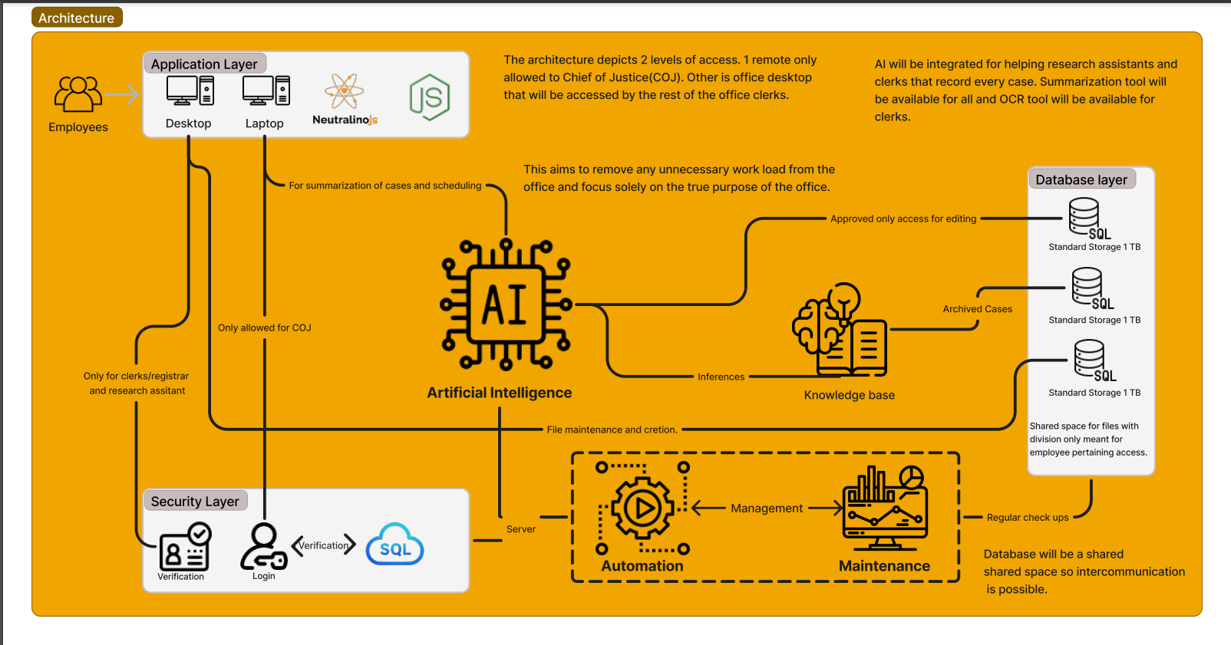

Slide 13
THANK YOU!

